Slide 1
User Defined Classes

Slide 2
Why Classes?
Sometimes it is natural to bundle data and behaviors together (technical term: encapsulation)
Python supports this bundling by allowing the programmer to define a class (like, for example, the str class)
A class may have arbitrarily many instances
this allows all members of the class to have uniform characteristics
for example, the class Dog might have instances fido, barker, and scrawny

Slide 3
Example: The Point Class
We can define a class that describes points in the plane with this code
class is a Python keyword (required)
Point is the name of the class (by convention, it is capitalized)
the colon (:) introduces the indented body of the class definition
the first thing in the class definition should be a short docstring
class Point:
''' Represents a point in a Euclidean plane '''

Slide 4
Creating a Point
A class typically has a method (function) named __init__ that is called to create an object in the class
the method name __init__ by convention has two leading and and two trailing underscores to distinguish it from other identifiers
self refers to the object created. The other parameters define the initial state of the object
class Point:
''' Represents a point in a Euclidean plane '''
def __init__(self, x_coor, y_coor):
self.x = x_coor
self.y = y_coor

Slide 5
Creating a Module for a Class
Though it is not required, a class definition is usually saved in a separate .py file that can be imported as a module
e.g., the class Point would be saved in a file named point.py
the point module could then be imported and used to create points (think turtle module and turtle.Turtle() )
the module may contain related classes (Turtle and Screen)
methods and data are accessed by the dot (.) operator
>>> import point
>>> point.Point
<class 'point.Point'>
>>> center = point.Point(0,0)
>>> center.x
0

Slide 6
Creating a Point
Additional behaviors for a point object can be defined by adding methods to the class
class Point:
''' Represent a point in a Euclidean plane '''
def __init__(self, x_coor, y_coor):
self.x = x_coor
self.y = y_coor
def coordinates(self):
''' Return a tuple of the x,y coordinates of a point '''
return (self.x, self.y)
def move_to(self, x_coor, y_coor):
''' Assign new coordinates to a point '''
self.x = x_coor
self.y = y_coor

Slide 7
Extend the Point Class
Write a method named move that moves a point relative to its current location (follow the pattern of the move_to method)
Write a method named distance_to that calculates the distance between the current point and some other point.
The code below shows correct input and output for these methods
>>> import point
>>> center = point.Point(0,0)
>>> point_a = point.Point(1,1)
>>> center.distance_to(point_a)
1.4142135623730951
>>> point_a.move(5,3)
>>> point_a.coordinates()
(6, 4)

Slide 8
Class Data
A class may have data associated with it that applies to every object in the class
For example, the dimension of every point is 0. This should be defined inside the class, but outside any method.
class Point:
''' Represents a point in a Euclidean plane '''
dimension = 0
>>> import point
>>> a_point = point.Point(2,2)
>>> point.Point.dimension
0
>>> a_point.dimension
0

Slide 9
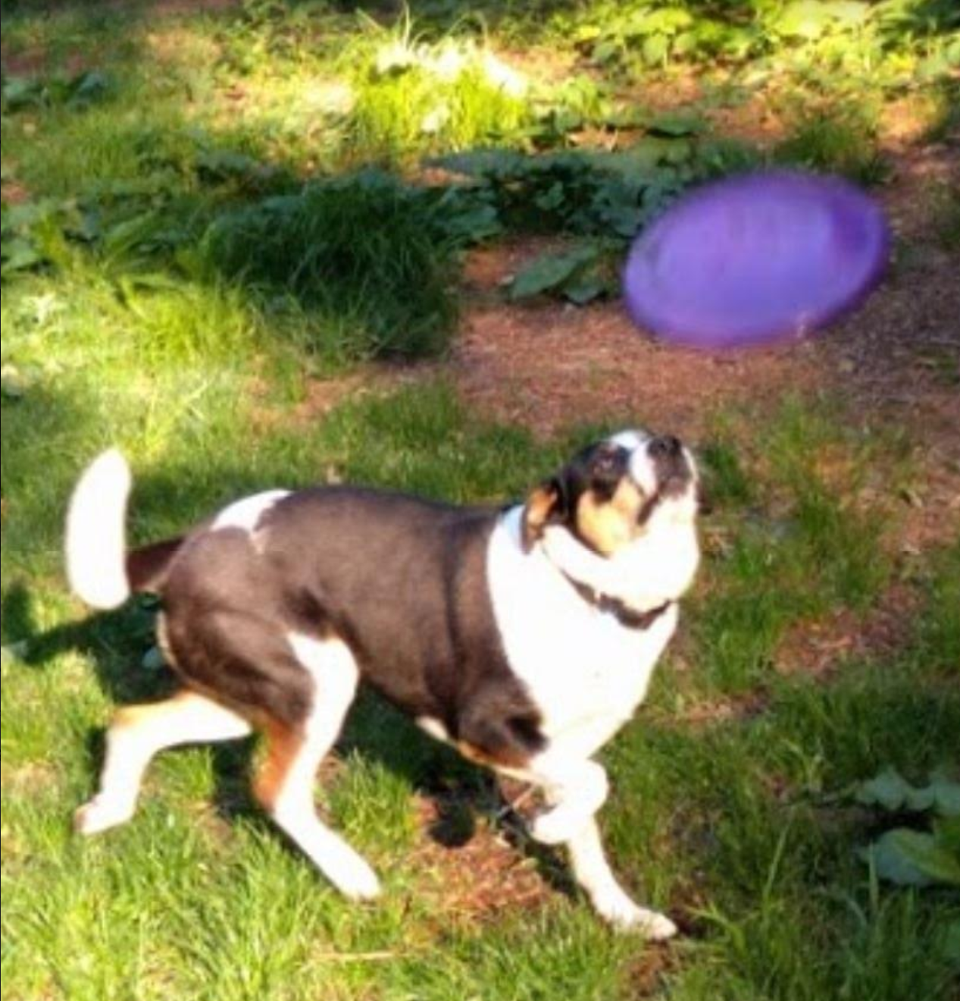
Sugar Knows Frisbee

